Slide 1

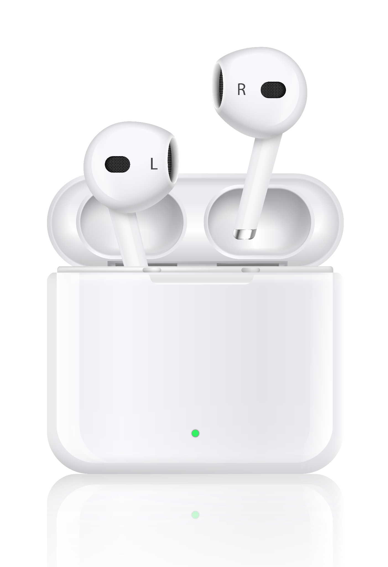
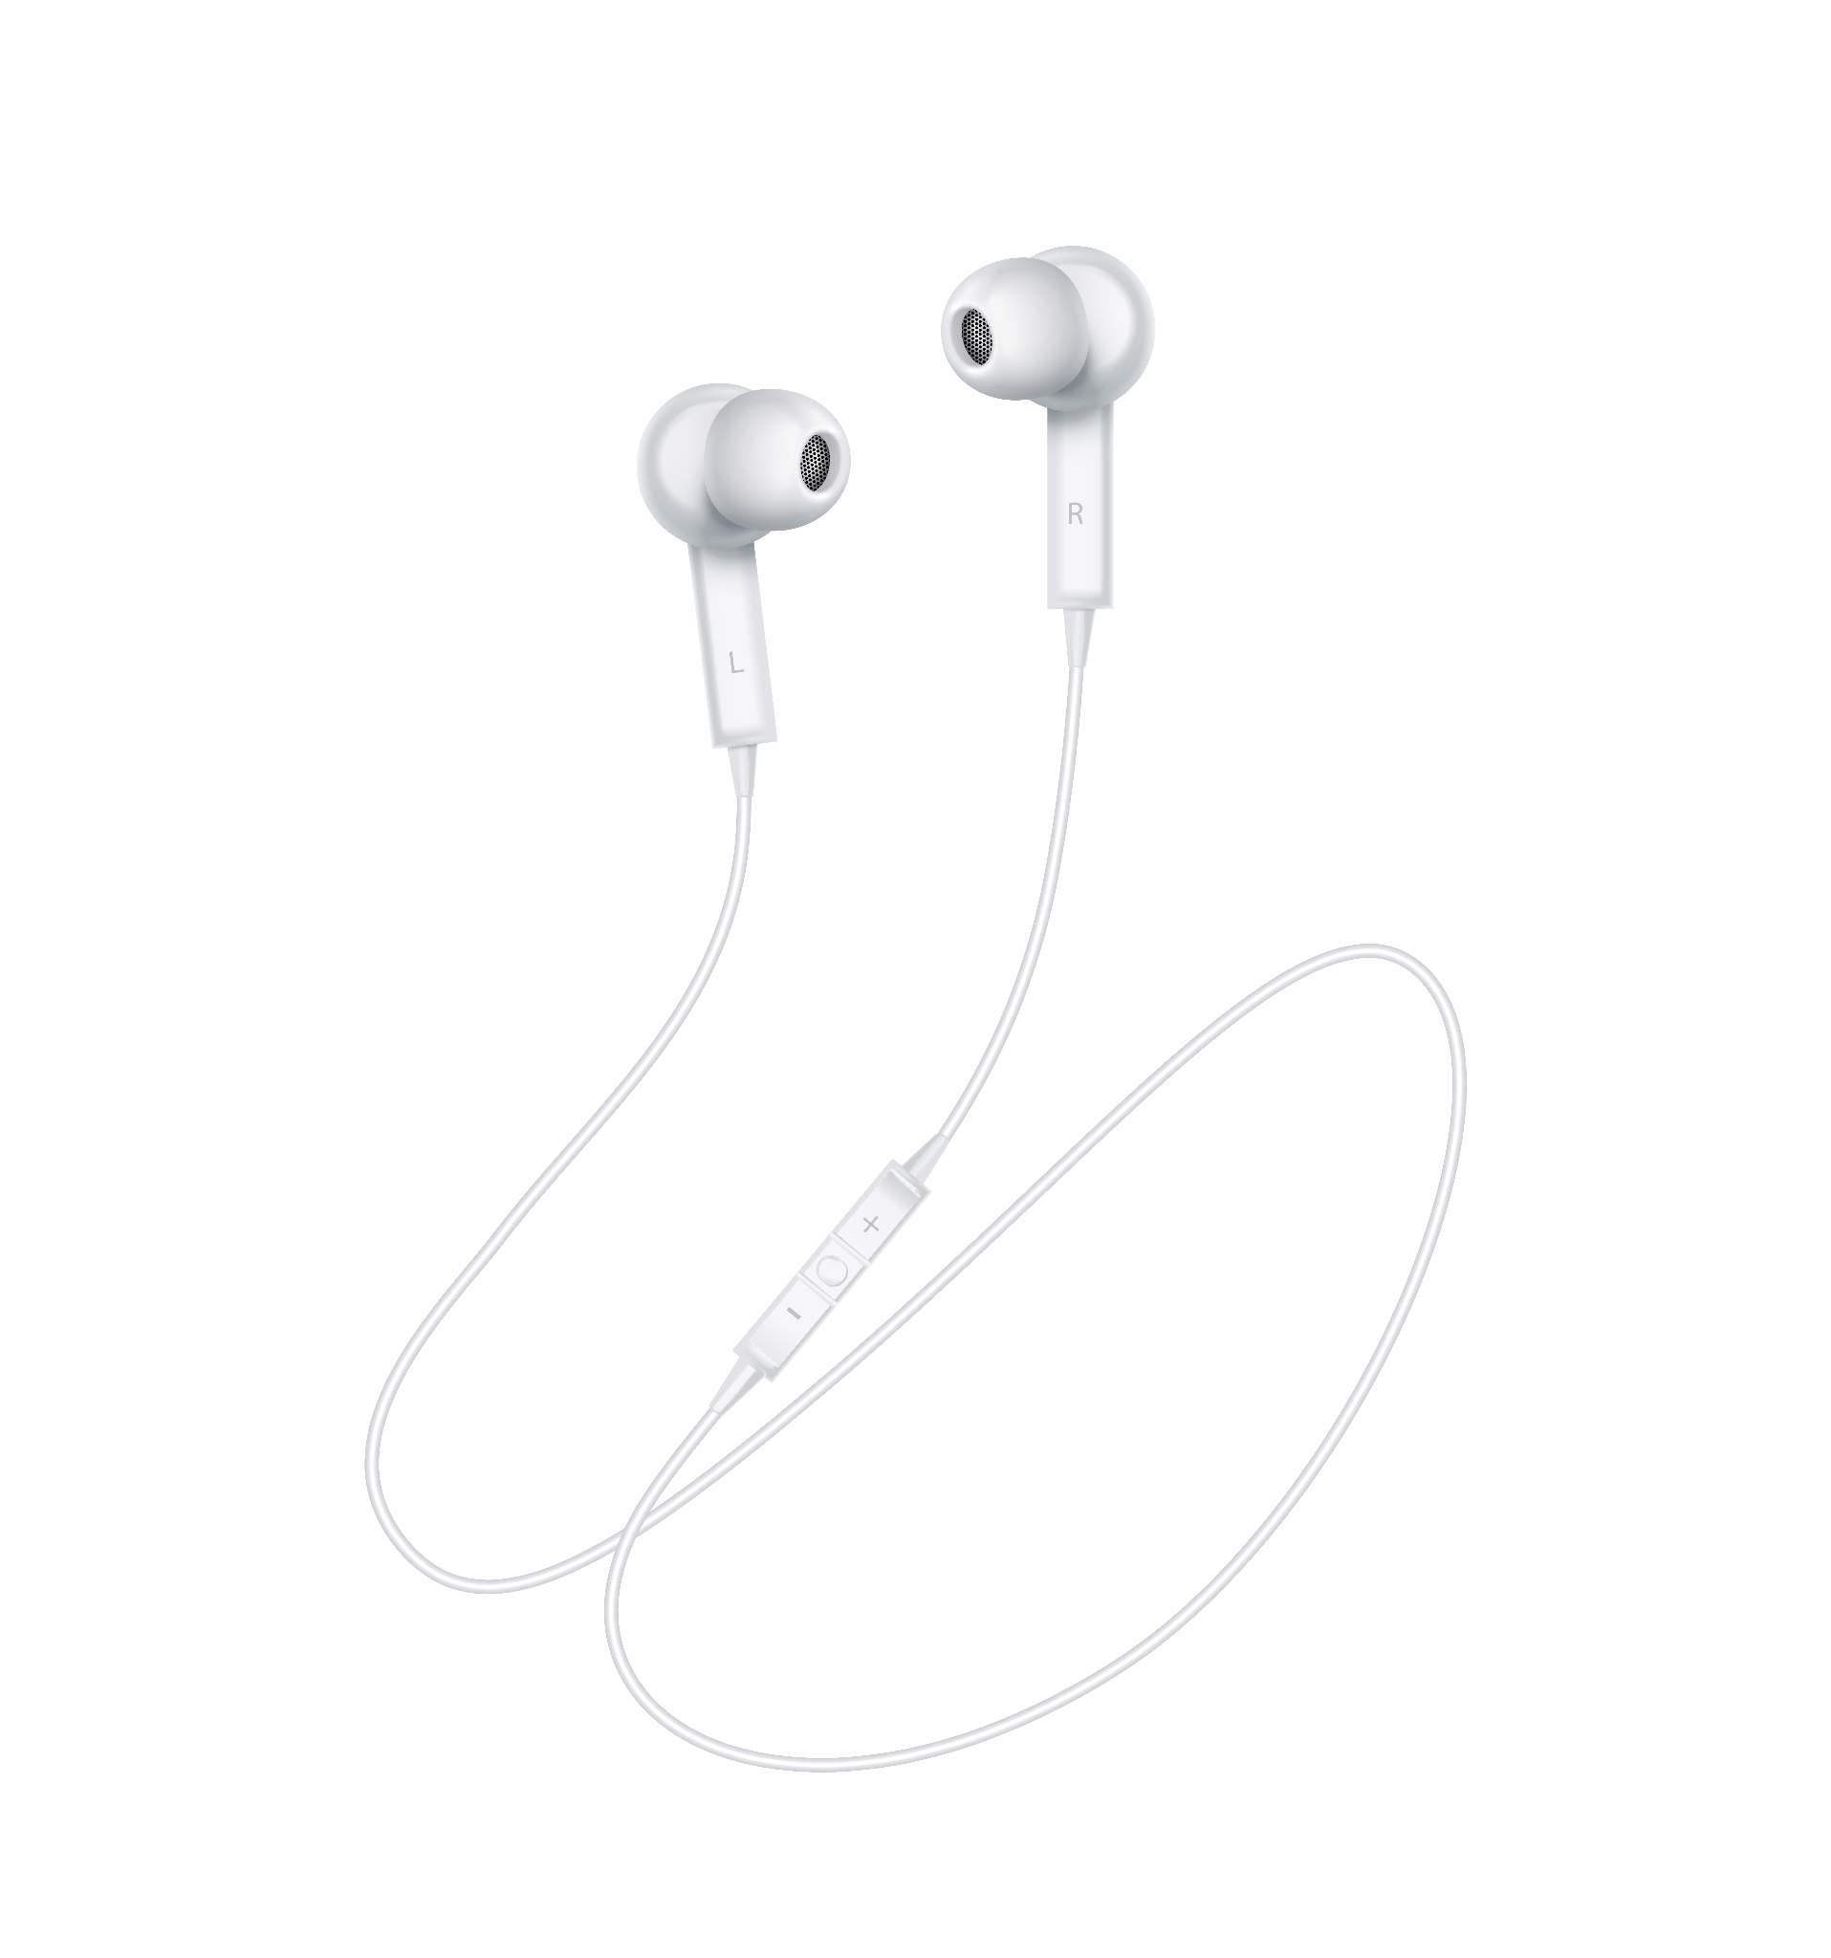
Apple Business Strategy
Yahli Kotler and Corey Zaslow

Slide 2

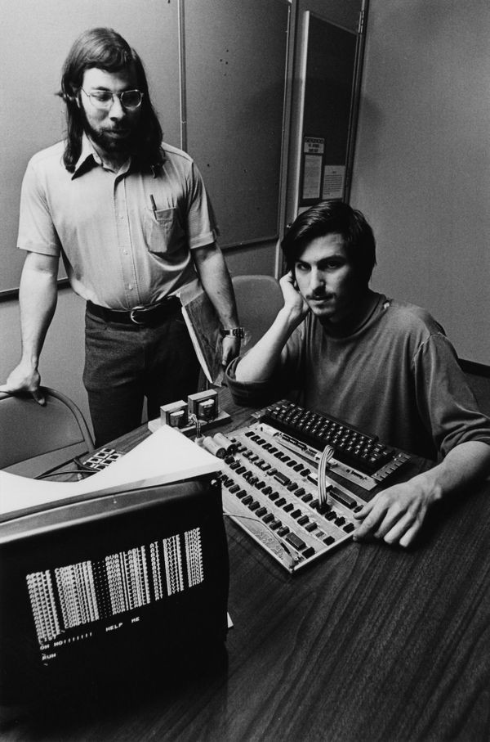
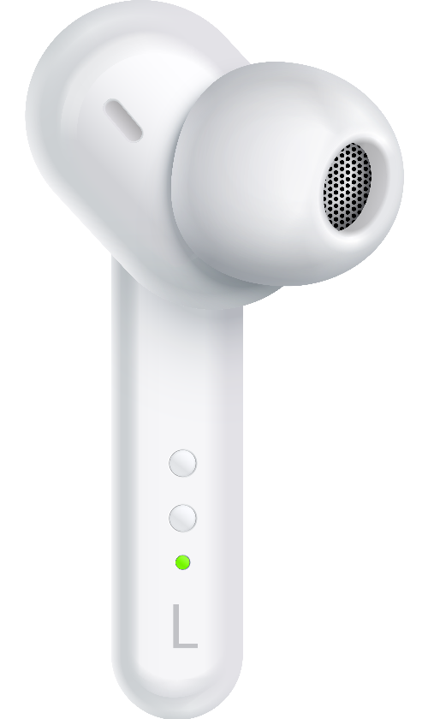
The Founding of Apple
April 1, 1976
Los Altos, California
Steve Jobs and Steve Wozniak

Slide 3
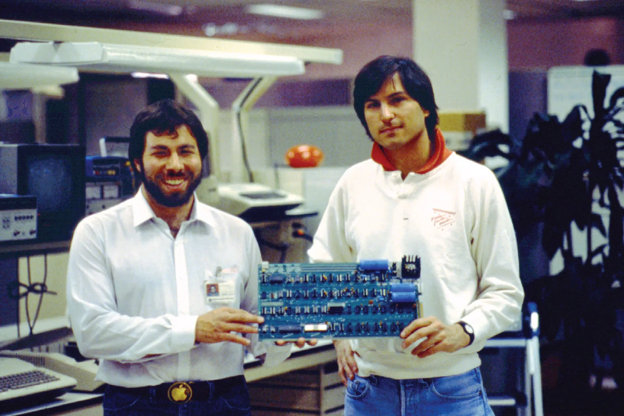
History of Apple’s Partnership
Jobs
Ideas
Marketing
Selling
Wozniak
Engineering
Building
Notes:
Their shared goal of making computers easy for everyday people helped drive Apple’s early success.

Slide 4
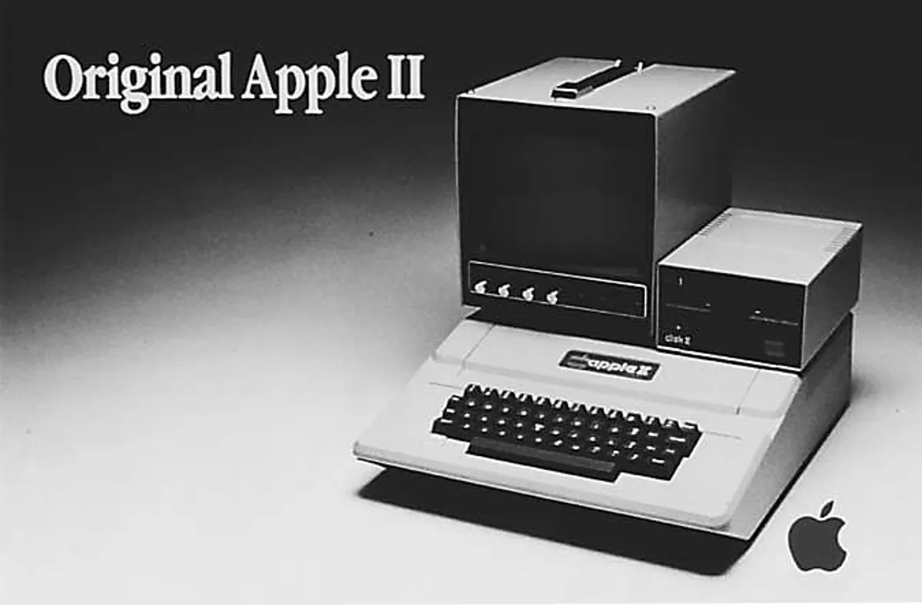
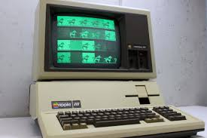
History of Apple’s Partnership
Over $100 Million in Sales
Mutual Respect
← Apple III Super Rushed, Led to Sales + Tech Issues
Notes:
By 1980, Apple reached over $100 million in sales after the release of the Apple II, showing massive early growth.
Their partnership was built on mutual respect, Jobs had vision, Wozniak had engineering skill.
However shortly after, the Apple III was released, but inevitably it damaged Apple’s reputation because it was rushed and had overheating issues, leading to poor sales.

Slide 5
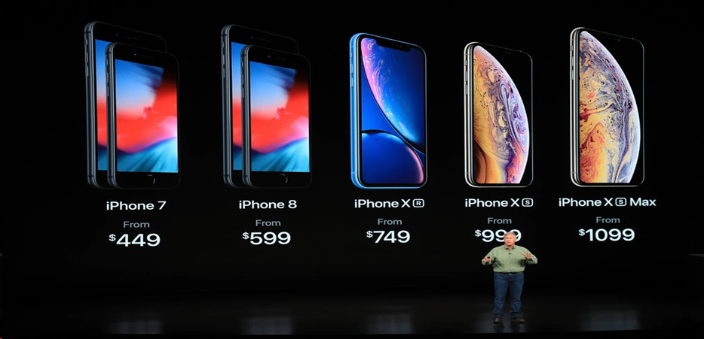
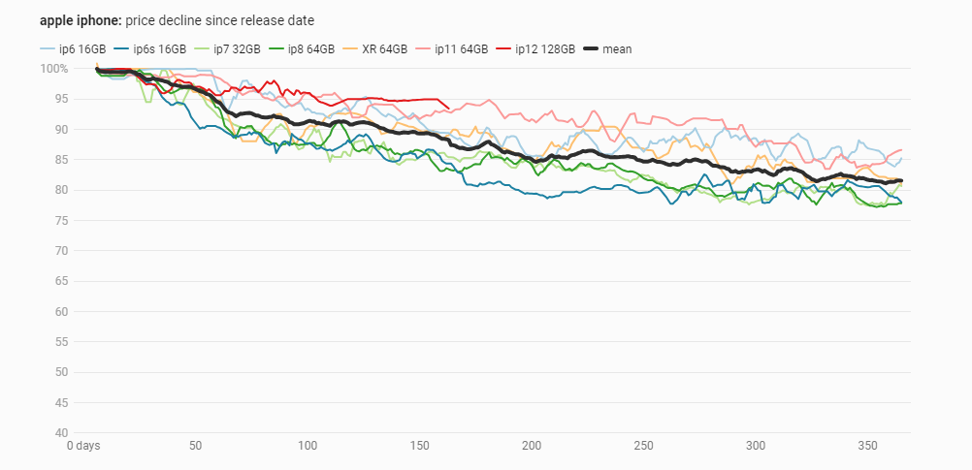
Apple’s Business Strategy
Marketing:
Price Skimming
Reinforces Exclusivity
Luxury Brand Image
Maximize Profits
Notes:
Apple uses price skimming—“setting an initial high price” to reinforce exclusivity and maximize early profits.
Its premium pricing “reinforces exclusivity… while maximizing profits during the product’s early lifecycle.”

Slide 6
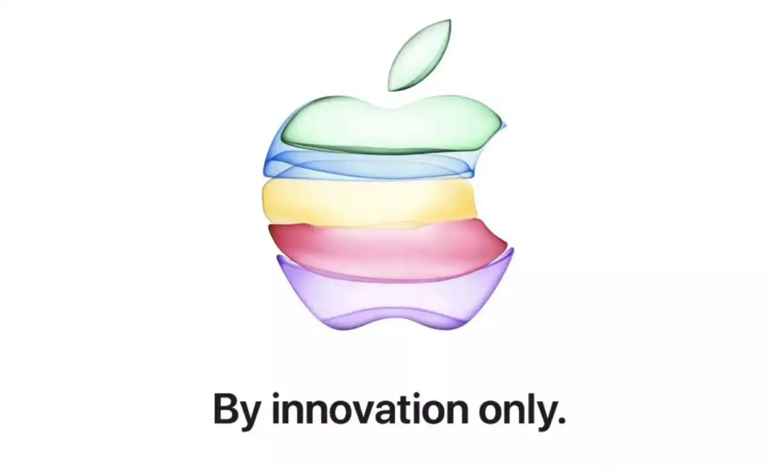

Apple’s Business Strategy
Innovation:
Reinventing Existing Products
Reinvention Through Self-Destruction
Increases Competition
Strengthens Apple
Notes:
Apple’s innovation strategy is rooted in Steve Jobs’s belief that “Innovation distinguishes between a leader and a follower.”
reinventing existing products using new technology, refining them internally, and releasing “successive better versions.”

Slide 7
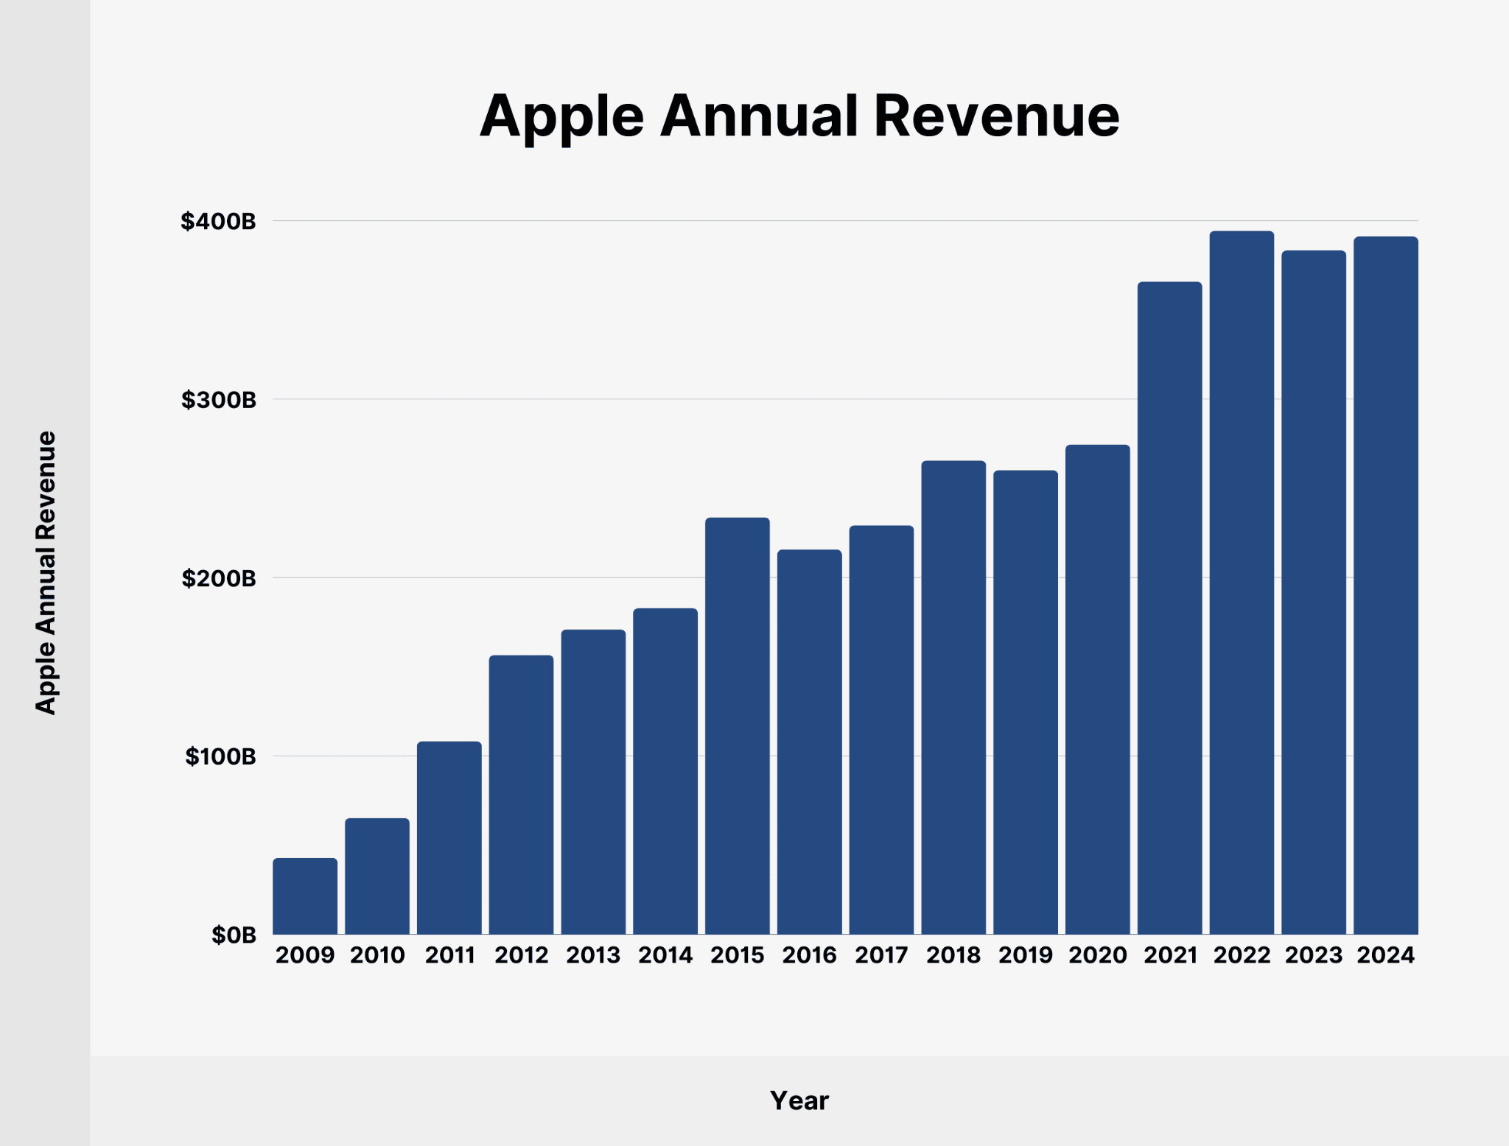
Apple’s Business Strategy
Finance:
Returned $29 Billion to their Investors
Prioritizes Shareholder Value and Financial Efficiency
Over $93 Billion in Profit in 2024
Notes:
High customer loyalty drives financial success, as Apple’s “installed base of active devices reached a new all-time high.”
Apple prioritizes shareholder value and financial efficiency, not just raw profit numbers.
Apple’s success results from the integration of marketing, innovation, and financial strategies, each reinforcing the others.

Slide 8
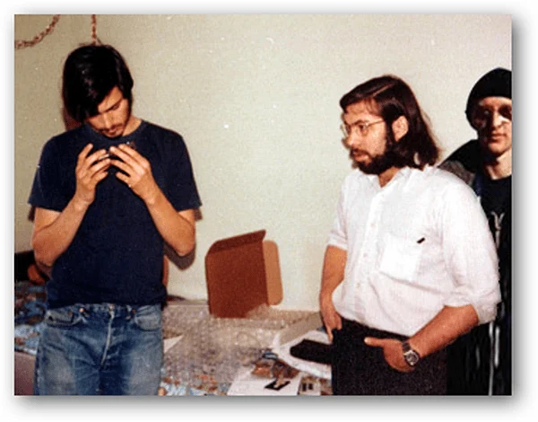

Partnership-Key Findings
Their Skills Complement Each Other
Different approaches for success
Wozniak’s Engineering allowed for Job’s Vision
Notes:
Complementary skill sets — Wozniak was the engineering genius who built the early Apple computers, while Jobs was the visionary who understood design, marketing, and user experience.
Shared ambition but different approaches — Both wanted to revolutionize personal technology, but Wozniak emphasized innovation for its own sake, while Jobs pushed for polished consumer products.

Slide 9
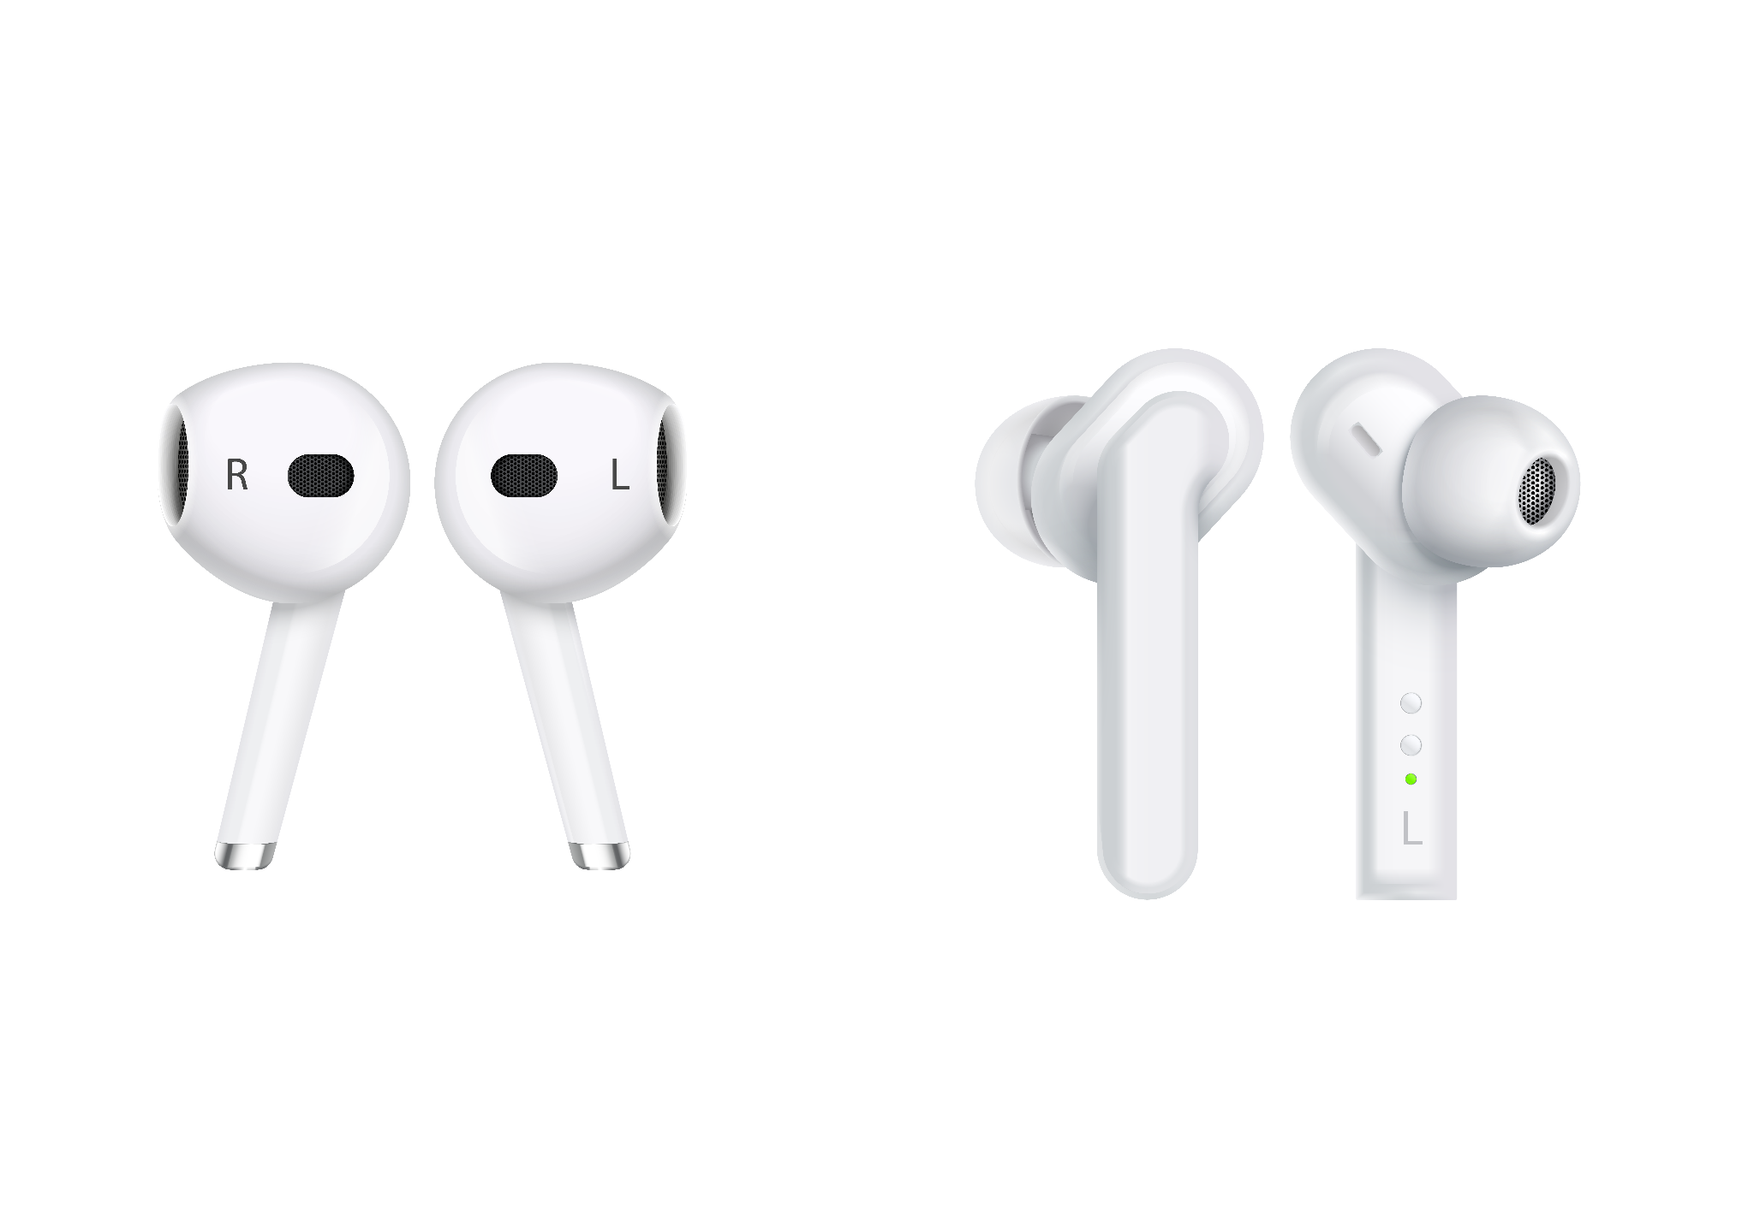

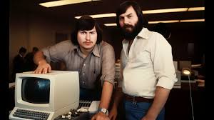

Notable Achievements
Out of Garage
Customer-Friendly
Complementary
Notes:
They founded Apple in Jobs’s family garage in 1976. Jobs convinced Wozniak to sell his calculator and he sold his Volkswagen van so they could fund Apple I production.
Woz built the computers; Jobs worked on the look, packaging, and getting stores to buy them. Their teamwork created some of the earliest user-friendly computers that regular families could use.
Their differences in personality complemented each other, and this actually made them powerful together. Further leaving an everlasting legacy on the tech and business world.

Slide 10
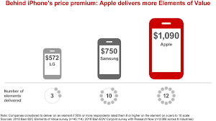
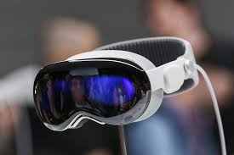
Flaw in the Business Model
Expensive Products
Unable to Afford Products
Feeling Trapped in Apple’s System
Notes:
Apple makes great products, but they are very expensive and only work best with other Apple devices.
This causes two problems:
Many people can’t afford Apple products.
Some customers feel trapped in Apple’s system because switching to another brand is hard.

Slide 11

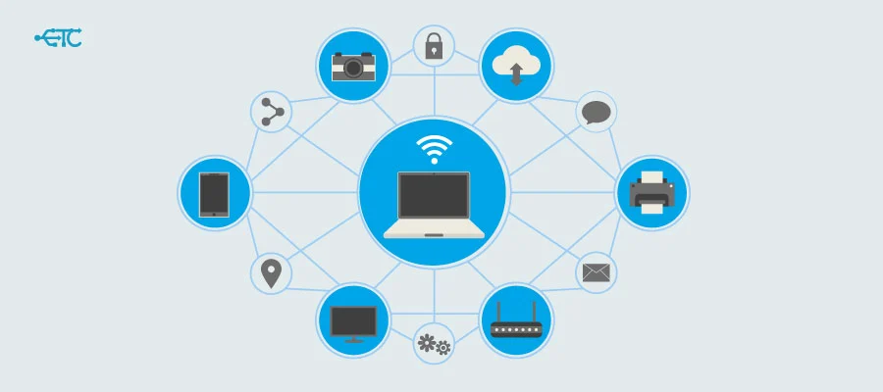
How to fix this problem:
Notes:
A simple solution is for Apple to offer lower-cost products and make those devices easier to connect with other brands. This gives more people the opportunity to afford Apple technology and customers won’t feel limited or locked into only using Apple products.

Slide 12
Works Cited
Works Cited
“Apple Reports Second Quarter Results.” Apple Newsroom , 2025, www.apple.com/newsroom/2025/05/apple-reports-second-quarter-results/. Accessed 25 Nov. 2025.
Hobson, Nick. “Steve Jobs Said What Separates a Leader from a Follower Really Comes down to This Mindset.” Inc, 8 Apr. 2023, www.inc.com/nick-hobson/steve-jobs-said-what-separates-a-leader-from-a-follower-really-comes-down-to-this-mindset.html. Accessed 25 Nov. 2025.
Hosch, William L. “Steve Wozniak | Biography & Facts.” Encyclopædia Britannica, 6 Sept. 2018, www.britannica.com/biography/Stephen-Gary-Wozniak.
“Inside Apple Marketing Strategy 2025 - Research by AdRankLab.” AdRankLab, 25 May 2025, www.adranklab.com/blogs/inside-apple-marketing-strategy-2025/. Accessed 25 Nov. 2025.
Lemelson-MIT. “Steve Jobs and Steve Wozniak | Lemelson.” Lemelson.mit.edu, 2023, lemelson.mit.edu/resources/steve-jobs-and-steve-wozniak.
Levy, Steven, and Karl Montevirgen. “Apple Inc.” Britannica, 23 Apr. 2025, www.britannica.com/money/Apple-Inc.
Neog, Debashis. “Capital Structure and Innovation Strategy at Apple Inc.: A Financial Case Study Approach.” | IJIRT |, vol. 11, 2025, ijirt.org/publishedpaper/IJIRT177407_PAPER.pdf. Accessed 25 Nov. 2025.
Pereira, Daniel. “Apple Marketing Strategy (2025).” Business Model Analyst, 28 May 2024, businessmodelanalyst.com/apple-marketing-strategy/?srsltid=AfmBOorkKra1dqMUssZgRobp_pMTFv9Fr_WOMgM-TfH-fuh9UzirK_FQ&utm_. Accessed 25 Nov. 2025.
Zaman, Rokon. “Apple’s Innovation Strategy - Creating and Monopolizing - the WAVES.” THE WAVES, 4 Mar. 2022, www.the-waves.org/2022/03/04/apples-innovation-strategy-creating-and-monopolizing/. Accessed 25 Nov. 2025.

