Slide 1

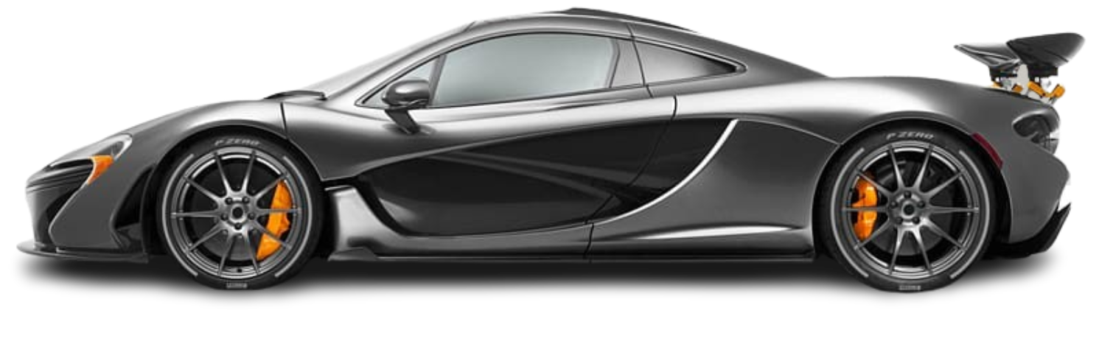
Launching McLaren’s First SUV
By: Yahli Kotler

Slide 2
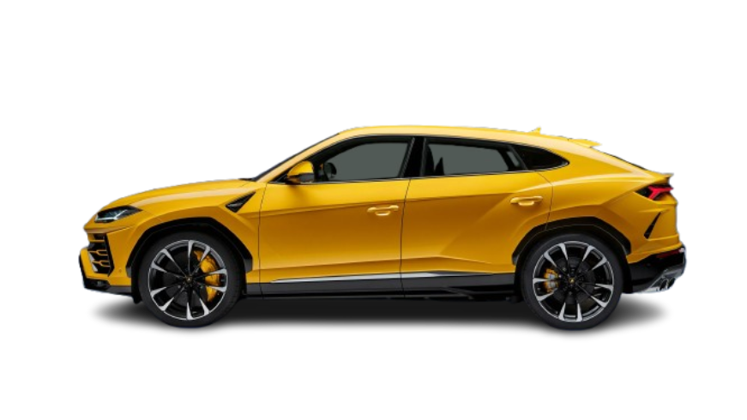
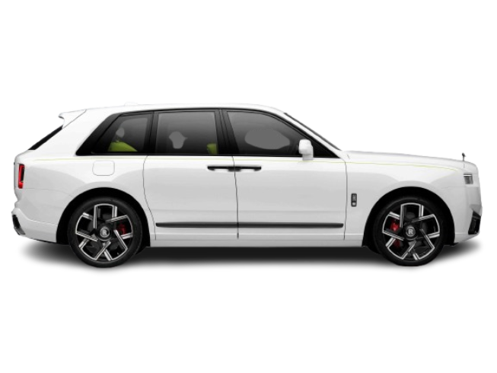
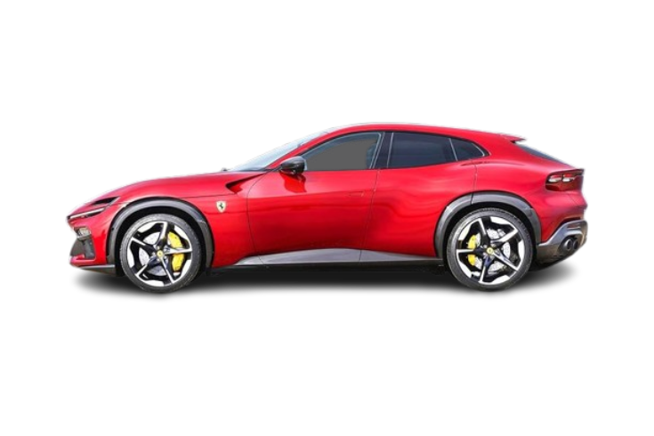
Why This Matters Now
Shift in the luxury market
Move towards SUVs
McLaren is currently absent from this shift

Slide 3
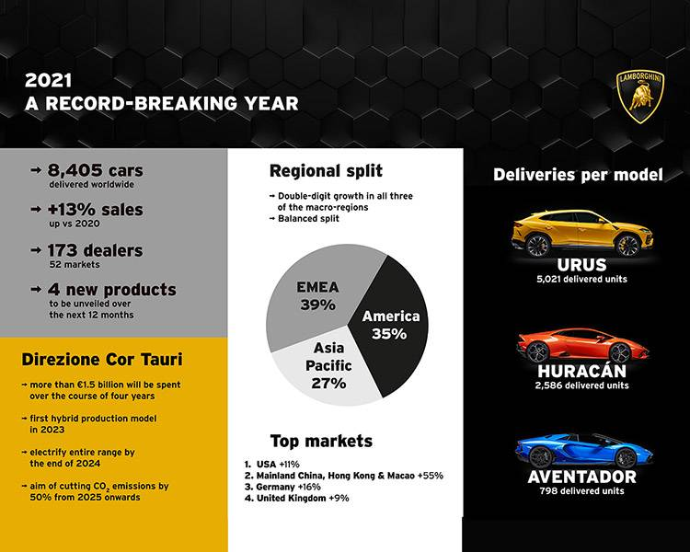
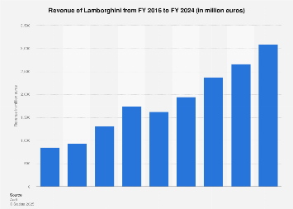
Market Proof
Competitor proof
Launch of Lamborghini Urus
Sales increased from 5,750 to 10,747
This also drives revenue growth in the luxury sector

Slide 4
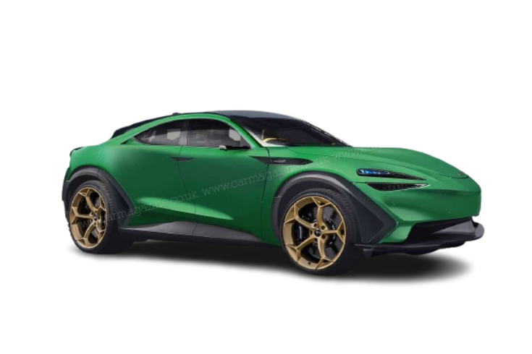
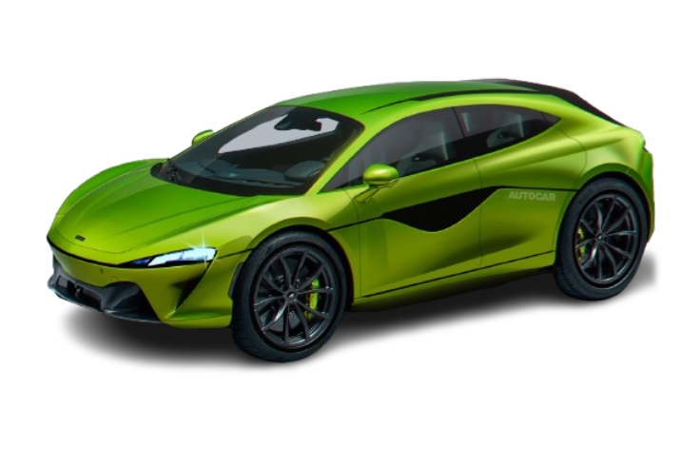
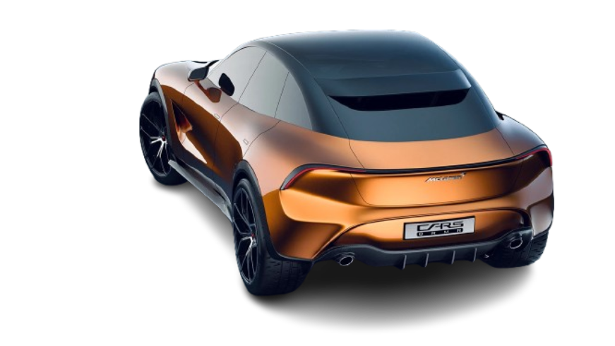
Factors of Product Strategy
MSRP set at $250,000
Limited to 337 units
U.S based launch
Positioning as a performance SUV

Slide 5
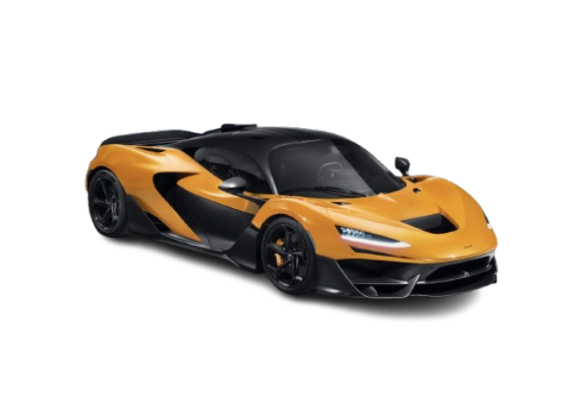
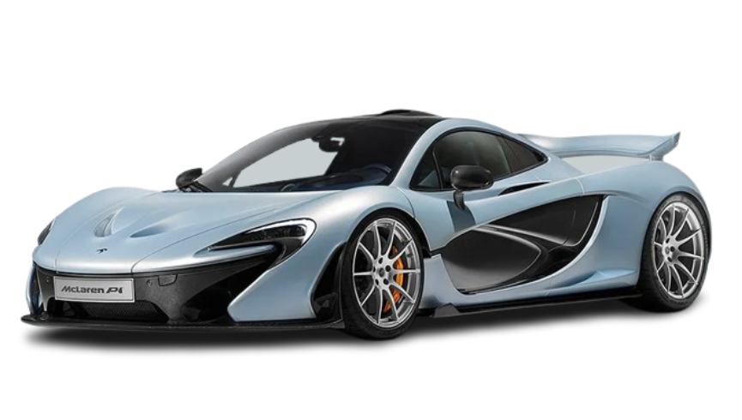
Revenue and Sales Impact
Projected Revenue of around $85 Million
Targeting 10% growth in revenue
Increasing annual vehicle sales over 3,500 cars

Slide 6
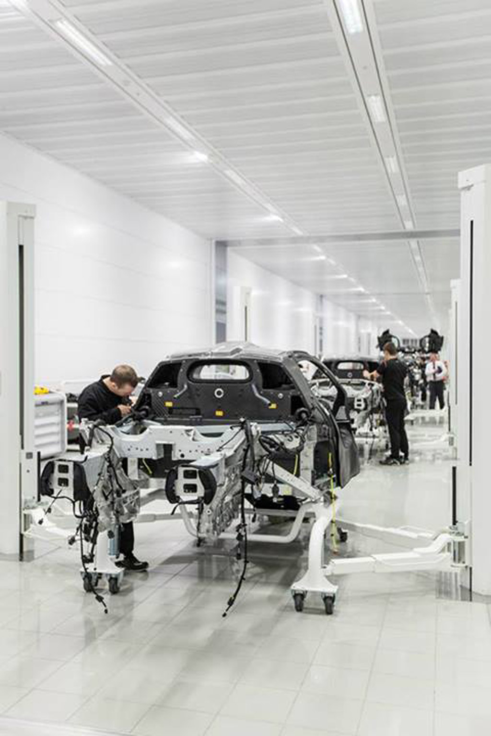
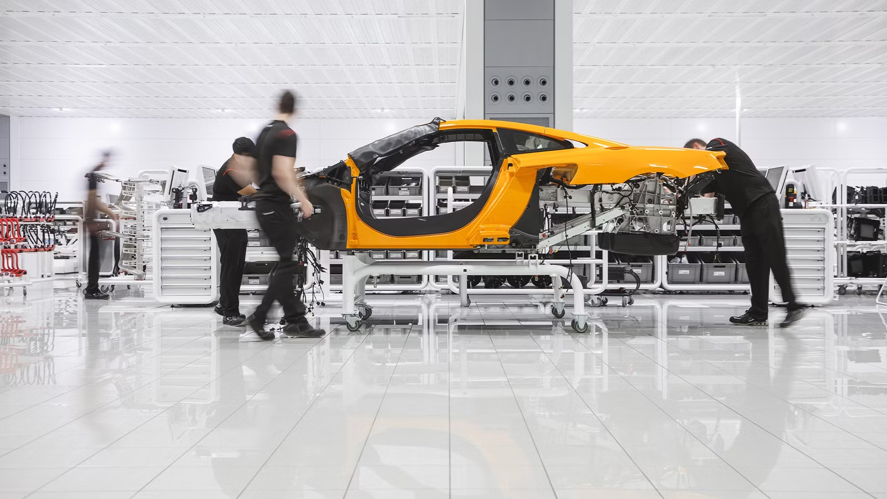
Investment and Budget
Budget of $100 million
Production costs at 55% of MSRP
High gross margins

Slide 7
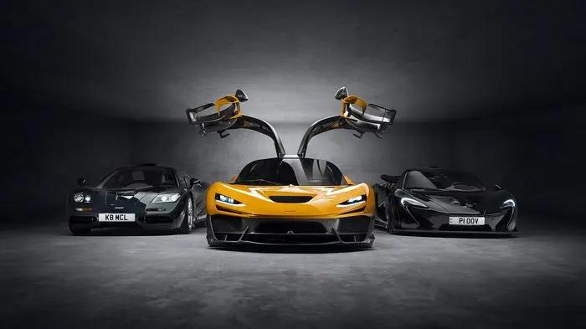
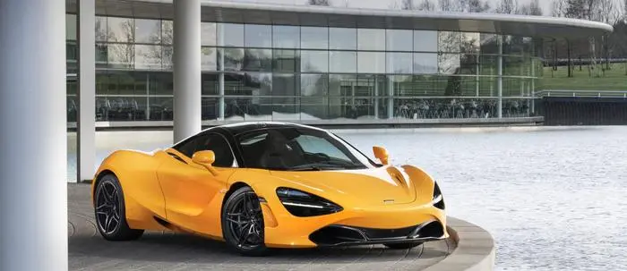
Financial timeline
Q1: Tracking revenue and cash flow
Q2: Begin to understand gross profit and ROI
Year 1: Near breaking even
Year 2 and onwards: High net profit

Slide 8
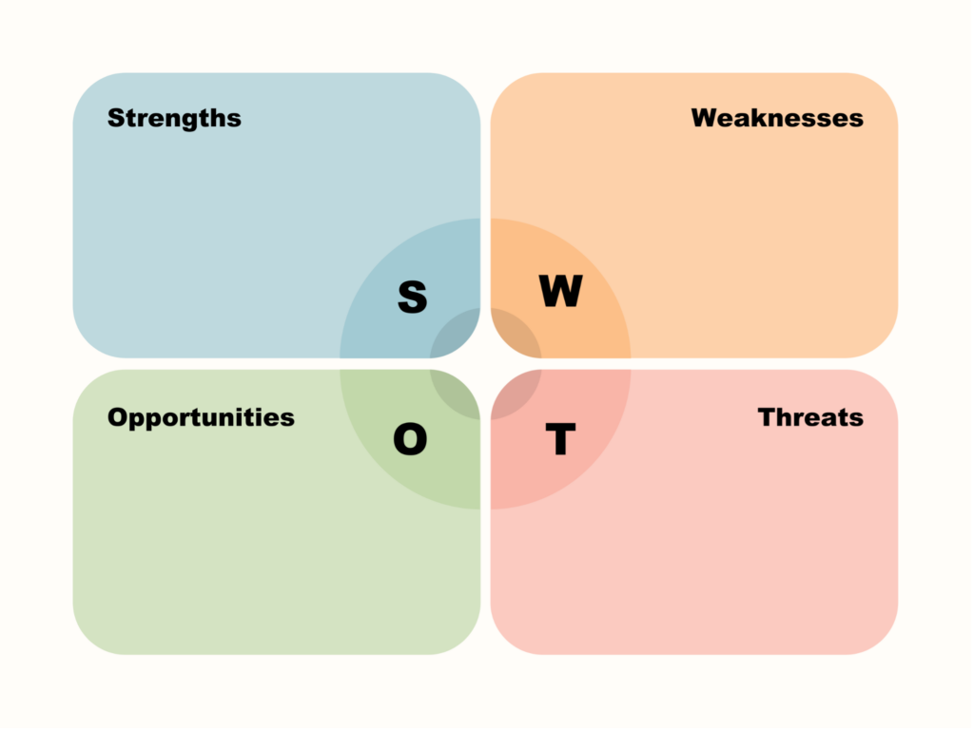
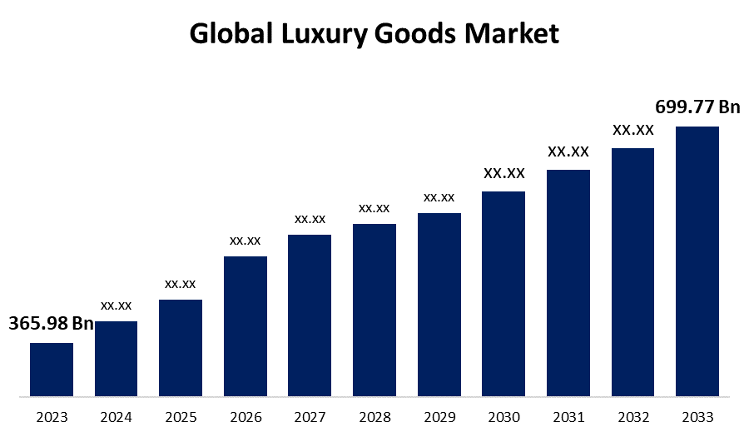
Managing Risk
Price elasticity of demand is minimal
Controlling supply reinforces exclusivity
Diversifies fleet beyond supercars
Competition is still strong

Slide 9

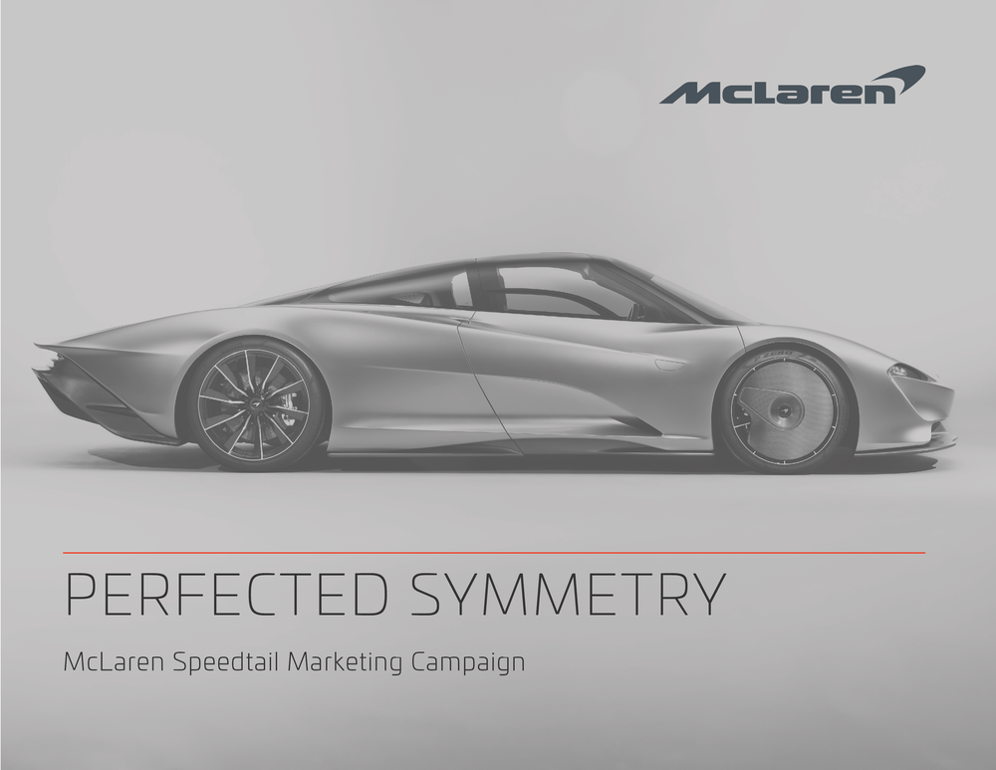
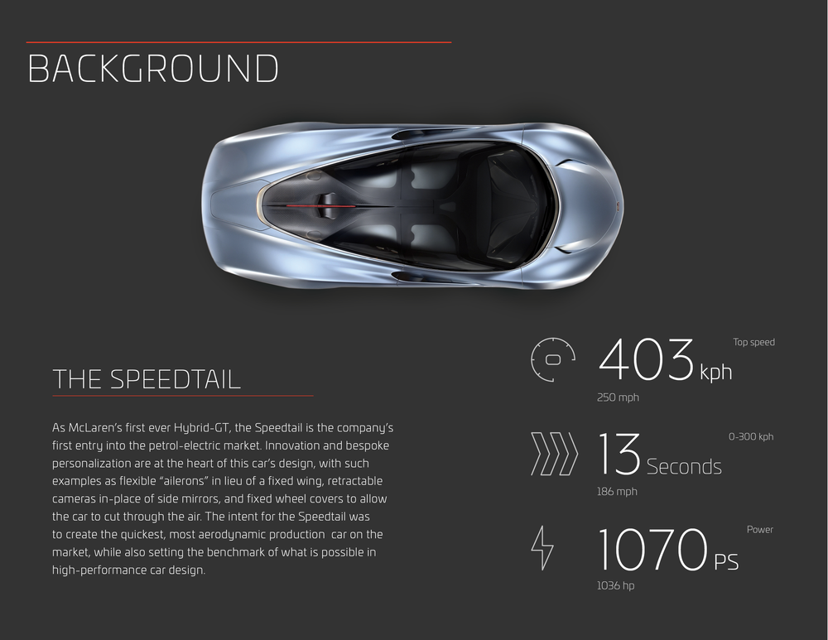
Staffing and Timeline
Using both internal and external recruiting
Some components of the car will be outsourced
Phase order: Design, Prototype, Production, Launch, Evaluation
3 month marketing campaign

Slide 10
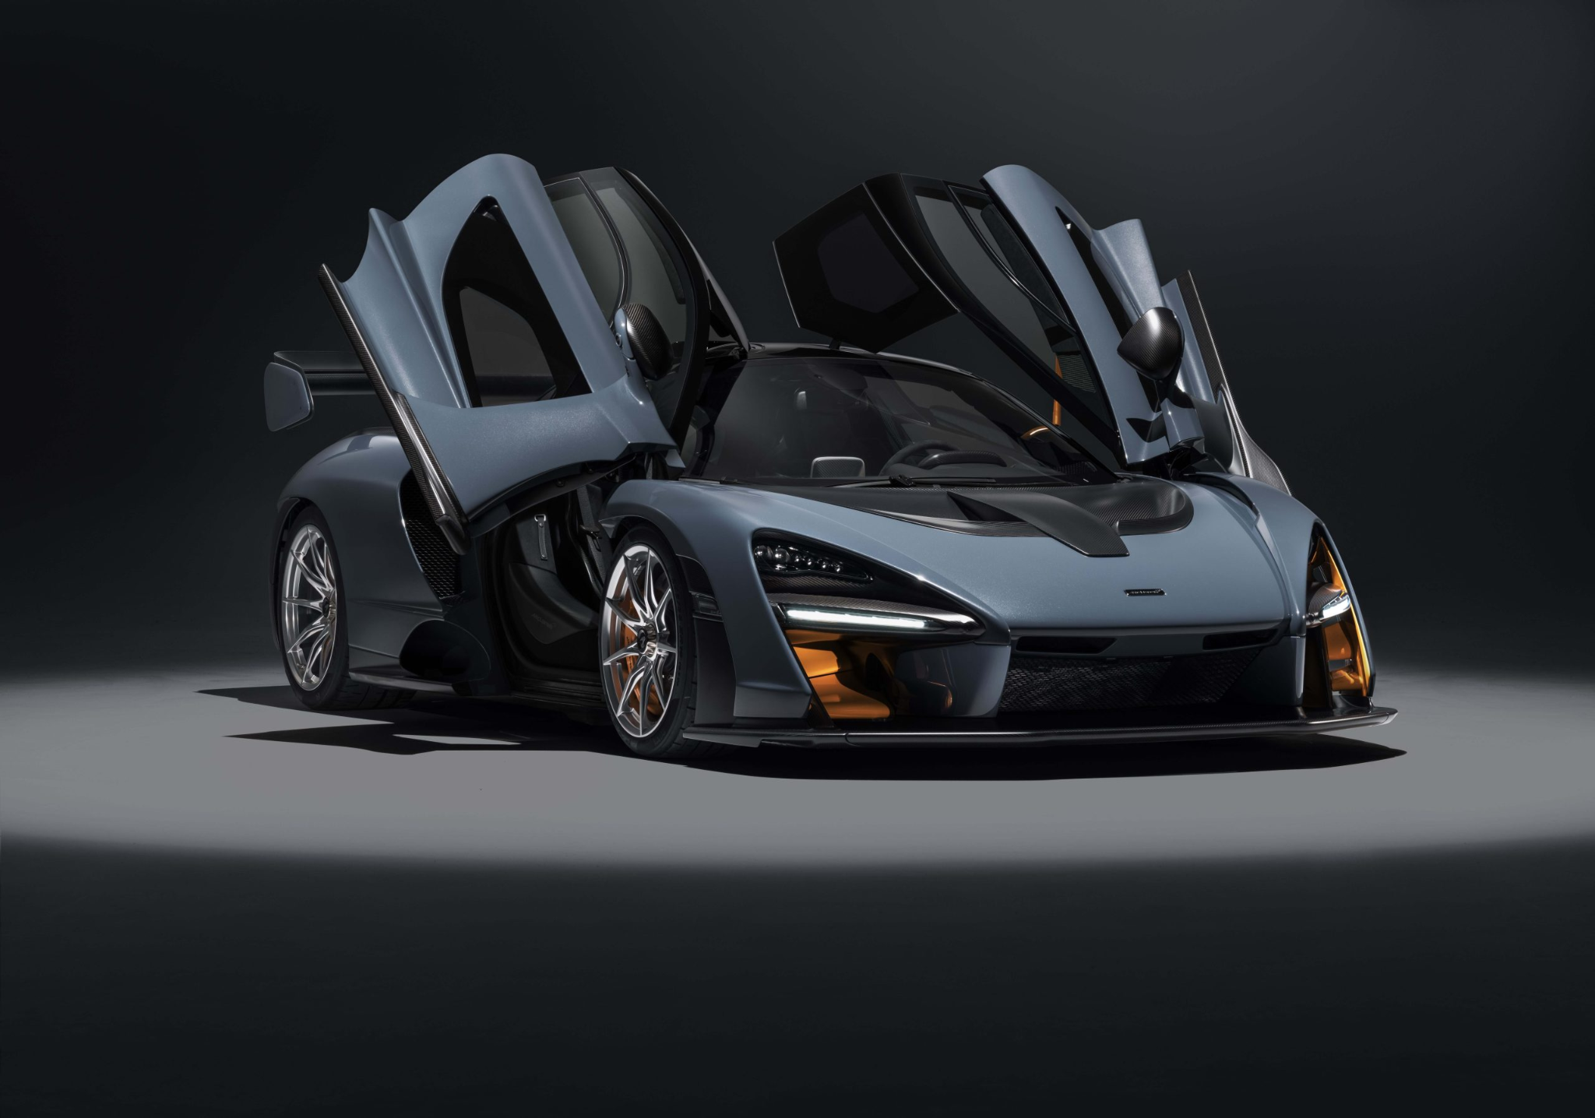
Strategic approval recommendation
Expand market share
Strengthen competitive positioning
Long-term profitability
Expand brand identity

Slide 11
Works Cited
Clarke, Chris. “Car Manufacturing Costs Exposed | What You Don’t Know.” YouTube, 28 Jan. 2025,
www.youtube.com/watch?v=EGcF9jmlXQI. Accessed 17 Feb. 2026.
“Getting to Know Today’s Luxury Car Buyer.” Glint Advertising, 27 May 2022,
glintadv.com/2022/05/27/getting-to-know-todays-car-buyer/. Accessed 16 Feb. 2026.
“Lamborghini Sets 2025 Delivery Record with 10,747 Cars.” Lamborghini.com, 29 Jan. 2026,
www.lamborghini.com/en-en/news/lamborghini-sets-2025-delivery-record-with-10747-cars.
“McLaren Automotive - Prepare, Commit, Belong.” Mclaren.com, 2025,
cars.mclaren.com/gl_en/about. Accessed 8 Feb. 2026.
McLaren Automotive Group Q3 (YTD) 2024 Results. 2024,
investors.mclaren.com/~/media/Files/M/McLaren-Services/results-centre/2024/q3-ytd-2024-results-presentations-v1.pdf.
“McLaren Sales Figures - U.S. Market.” GCBC,
www.goodcarbadcar.net/mclaren-us-sales-figures/. Accessed 8 Feb. 2026.
“McLaren W1 | Dynamic Testing at Silverstone.” Mclaren.com, 2024,
cars.mclaren.com/gl_en/W1/silverstone-dynamic-testing. Accessed 10 Feb. 2026.

